Slide 1
Transport Planning Society AGM 11 March 2021
Street Design: Covid-19 and beyond
Sally Gibbons
Head of Traffic Signs and Street Design Policy
Traffic and Technology Division

Slide 2
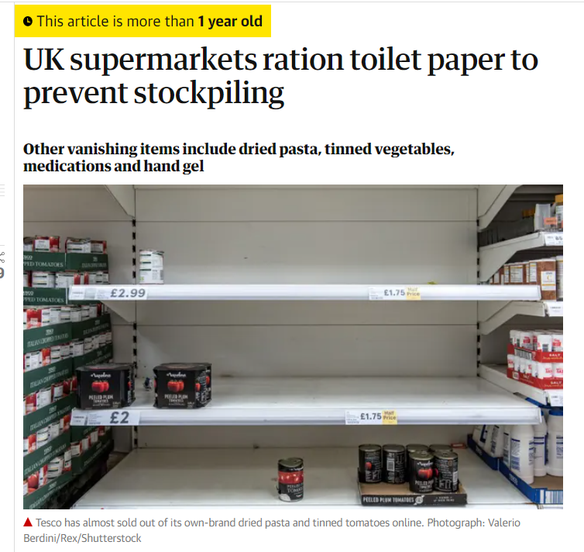
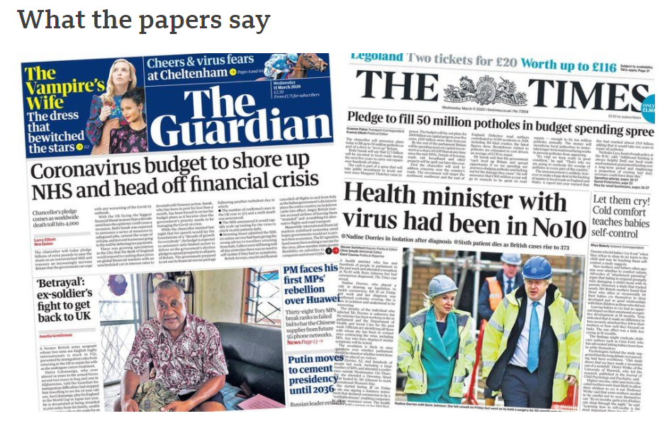
This time last year…

Slide 3
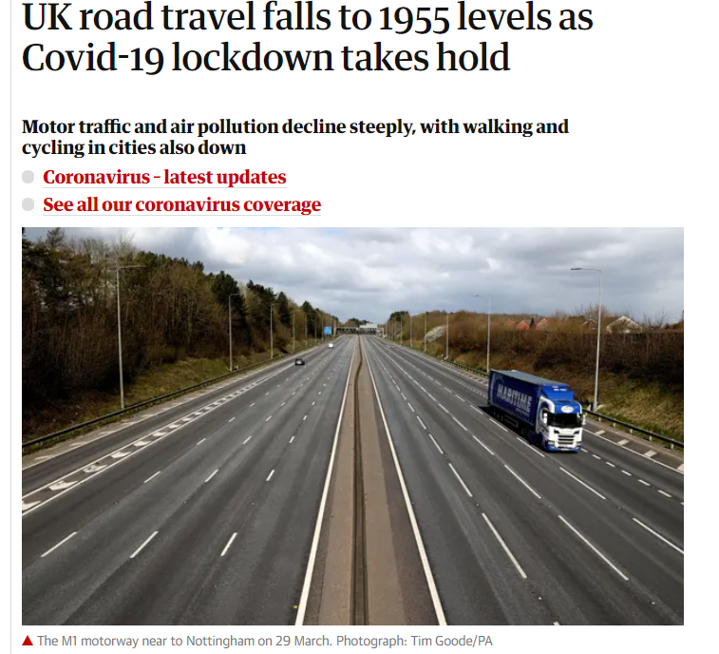
April 2020: Lockdown 1
Motor traffic levels down
More walking and cycling
Air quality improved
Birdsong!

Slide 4
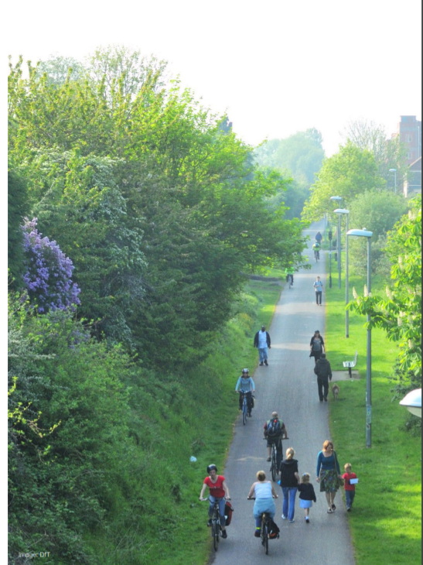
May 2020: Restart challenge
How do we embed the positive changes and encourage a ‘green restart’ while public transport capacity is constrained?
How do we accommodate social distancing requirements?

Slide 5
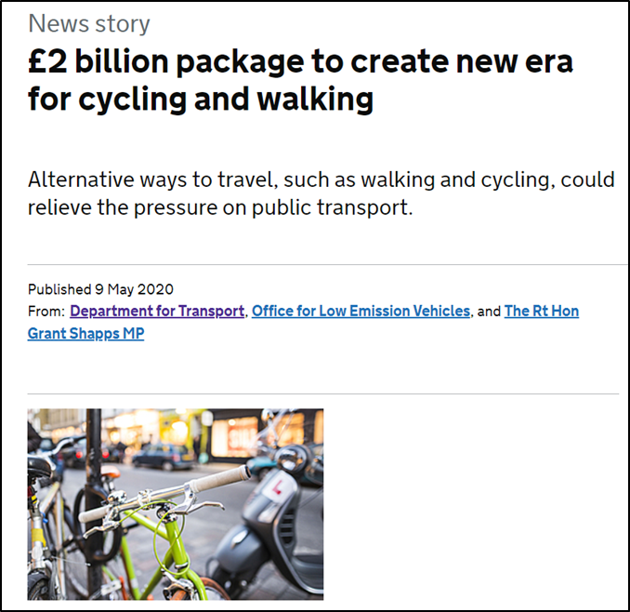
Emergency Active Travel Fund
£225M for active travel measures in 2 tranches
Tranche 1: July 2020
Tranche 2: November 2020

Slide 6
Network Management Duty Guidance
Statutory guidance: Traffic Management Act 2004
Local authorities must ‘have regard’ to it
Time constraints:
Short and high-level
Highlights existing tools
Provides strong direction for LAs
Review within 3 months

Slide 7
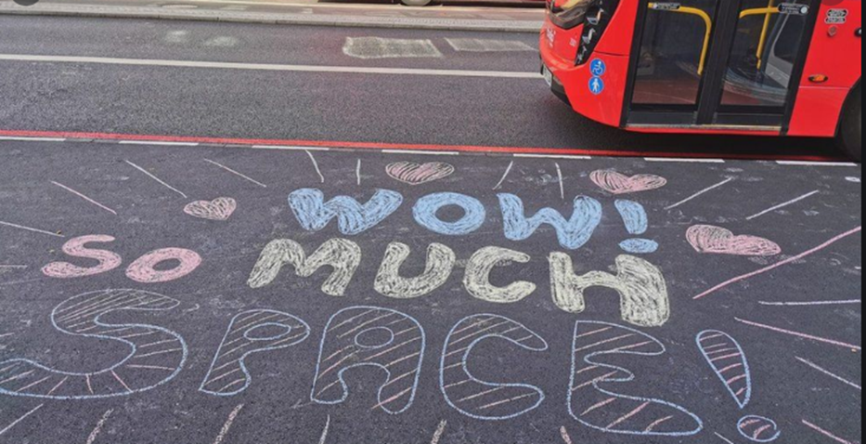
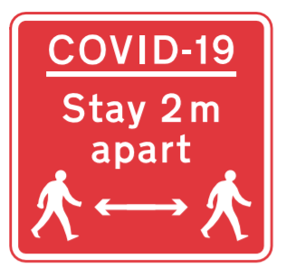
Focused on temporary measures
Pop-up cycle lanes
Widened pavements
Low-traffic neighbourhoods
School Streets
Signs for social distancing

Slide 8
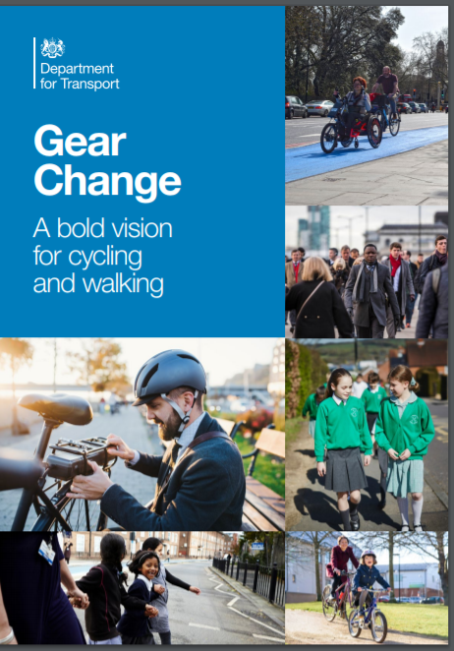
Gear Change: 28 July
“A future where half of all journeys in towns and cities are cycled or walked”
Four themes:
better streets for cycling and people
cycling and walking at the heart of decision-making
empowering and encouraging local authorities
enabling people to cycle and protecting them when they do

Slide 9
Positive feedback:
Government should act in local neighbourhoods to:
increase road safety (88%),
improve air quality (86%),
reduce traffic congestion (83%)
reduce traffic noise (75%).
65% of respondents were in favour of reallocating space to walking and cycling in their local areas
https://www.gov.uk/government/publications/public-attitudes-towards-traffic-and-road-use

Slide 10
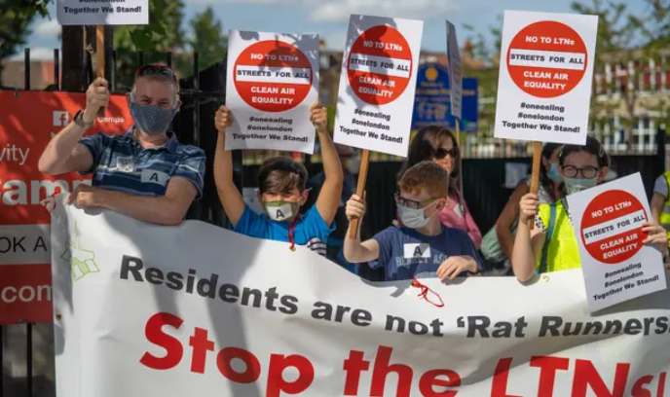
Lessons learned:
Community engagement is key…
… as is local political support
Short timescales (though necessary) didn’t help
Be prepared to make adjustments in the light of feedback

Slide 11
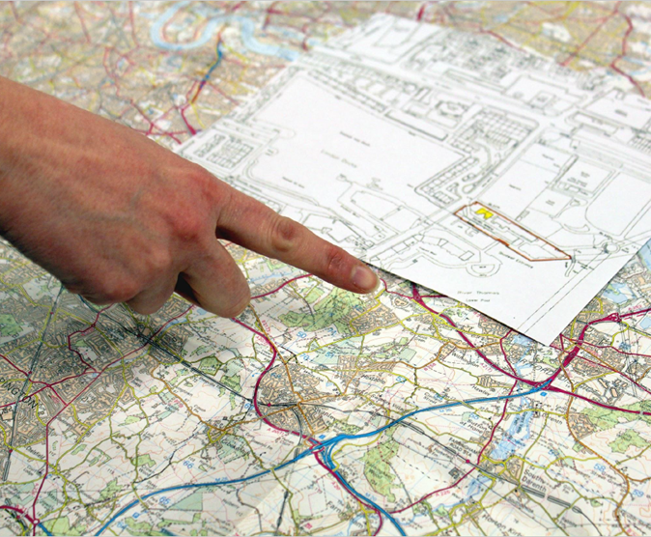
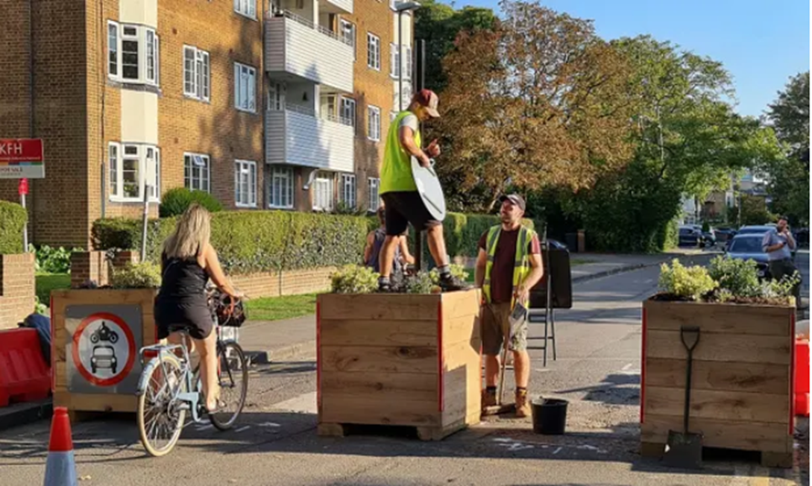
The future of streets?
How will people use streets differently?
How will people’s journeys change?
What happens to high streets?
How can we influence this?

Slide 12
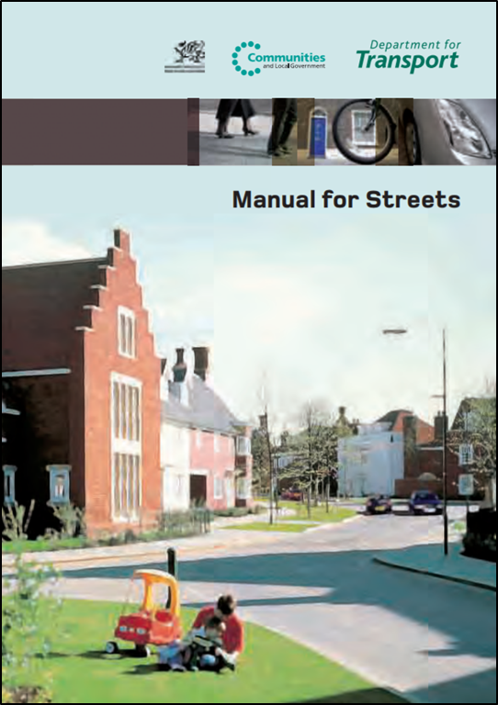
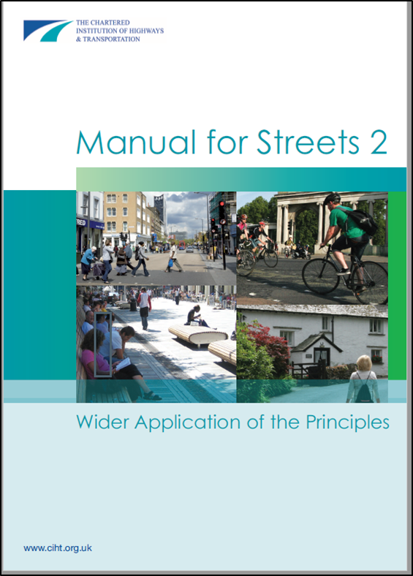
“Better places”
Low-traffic neighbourhoods
Mini-Hollands
Walkable neighbourhoods
20-min neighbourhoods
Healthy Streets
Home Zones
‘Summer Streets'
… and more

Slide 13
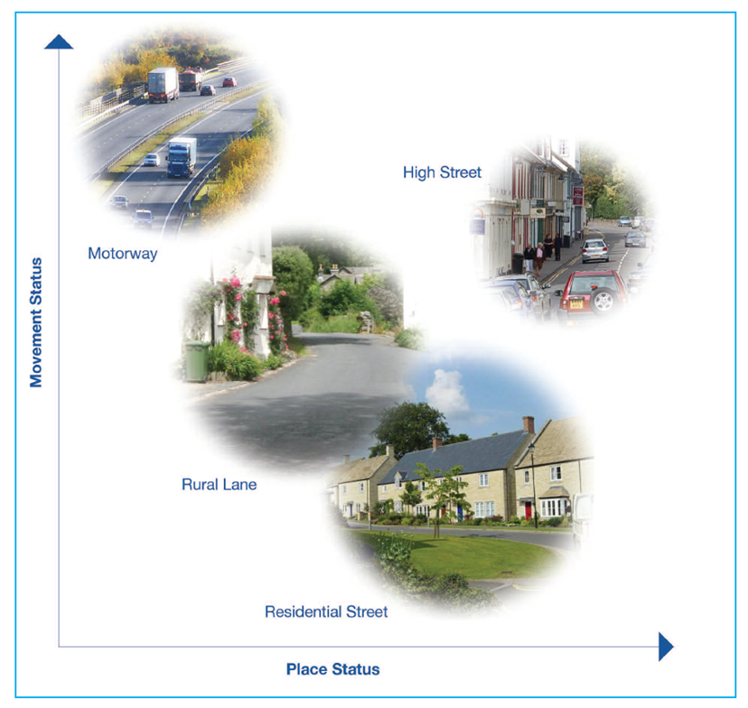
The importance of good streets
Streets and roads make up three quarters of all public space
Almost every journey involves using the street in some way
Streets are also the ‘glue’ that enables access to other modes of transport.
Notes:
Getting the street right is important for everyone

Slide 14
Benefits of good design
Better places:
Improve physical and mental health
Improve safety
Provide economic benefits
Provide better air quality

Slide 15
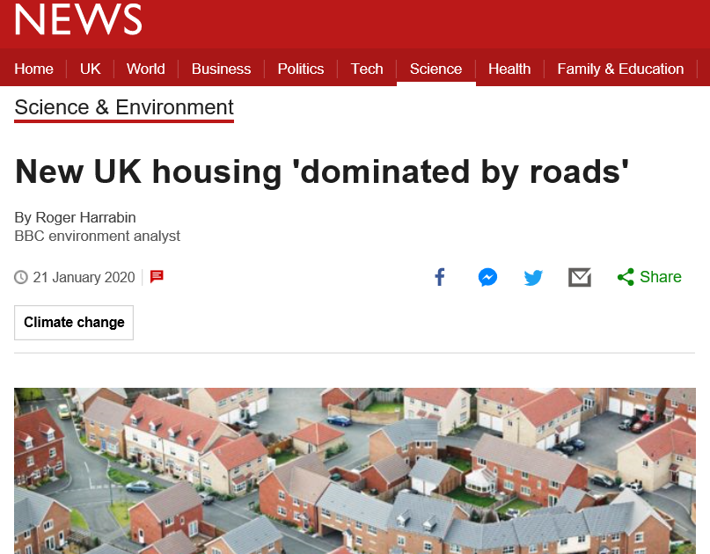
Updating Manual for Streets
Published in 2007, MfS 2 in 2010
The planning framework has changed
Uptake is not as high as we’d like
Poor development is still happening
MfS can help deliver other policies

Slide 16
What’s happening?
Grant-funding to CIHT
WSP appointed as consultants Dec 2020
Stakeholder engagement getting underway

Slide 17
Who’s involved?
Wide range of stakeholders:
DPTAC
Highways professionals
Developers
Road user groups
Public health
Air quality
… etc

Slide 18
Planning policy links
National Model Design Code
National Planning policy framework
Planning White Paper?

Slide 19
Help create better places for people to live and work in, and enjoy spending time in

